Slide 1
DIPOLE ANTENNA

Slide 2
Objective : To design a finite length dipole antenna.
What is a Antenna?
Antenna is a transducer that converts radio signal into voltage at receiver and voltage into radio signal at transmitter.
Let’s Understand the working of antenna.

Slide 3
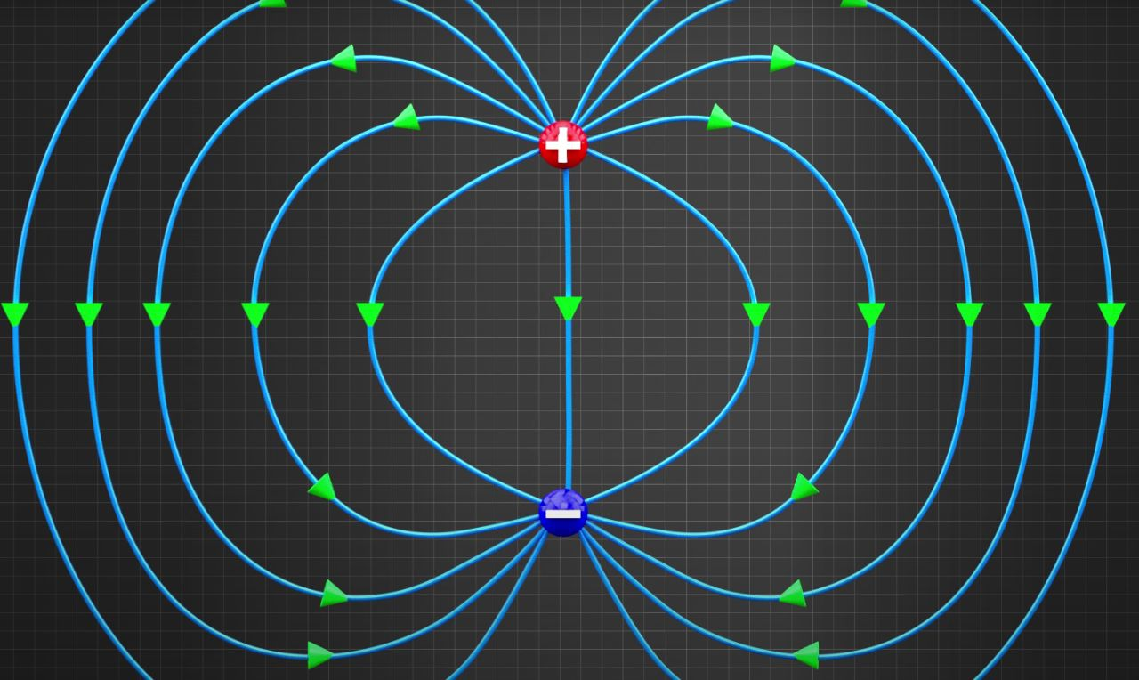
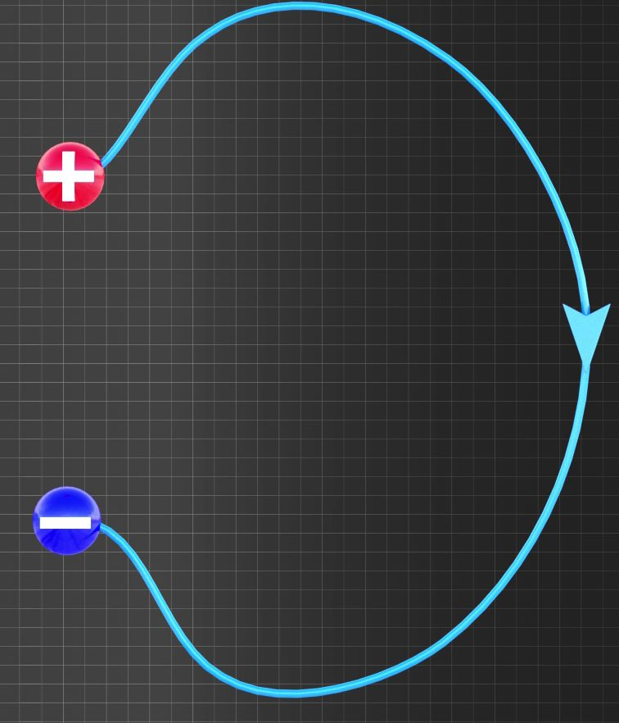
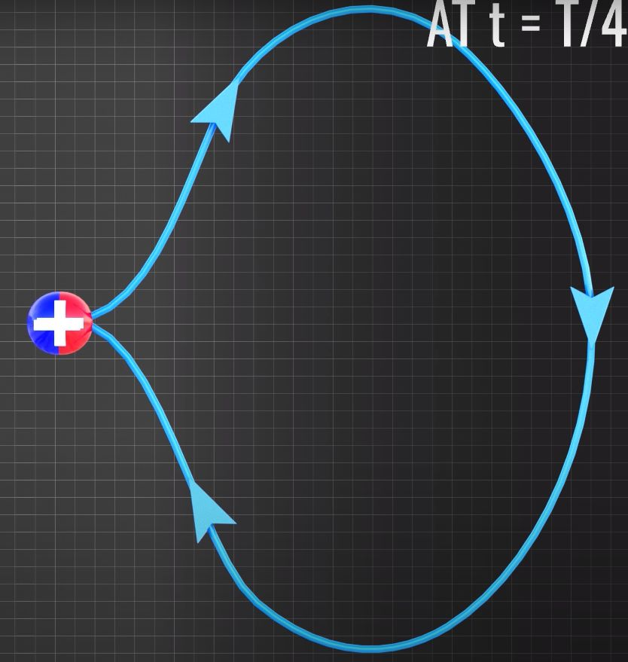
t=T/8
t=T/4

Slide 4
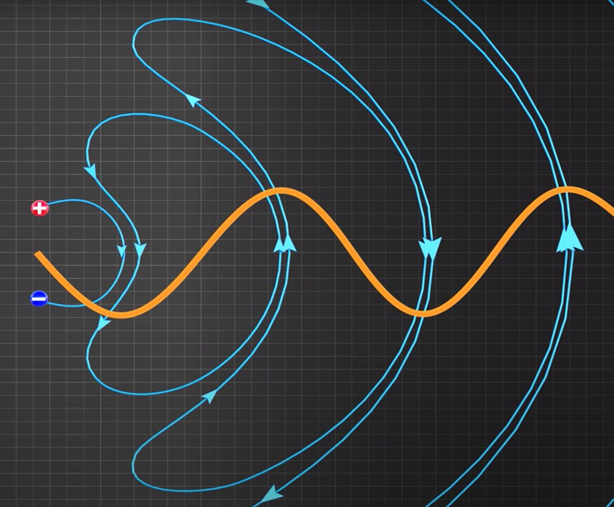

Slide 5
How to practically realize it ………

Slide 6
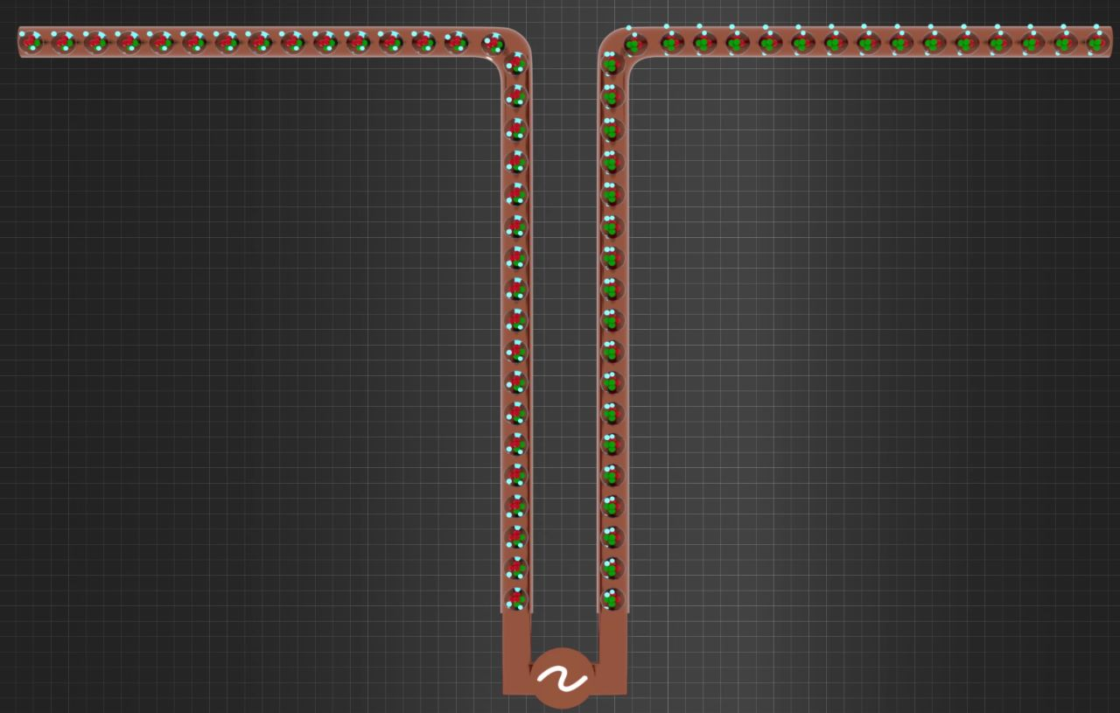

Slide 7
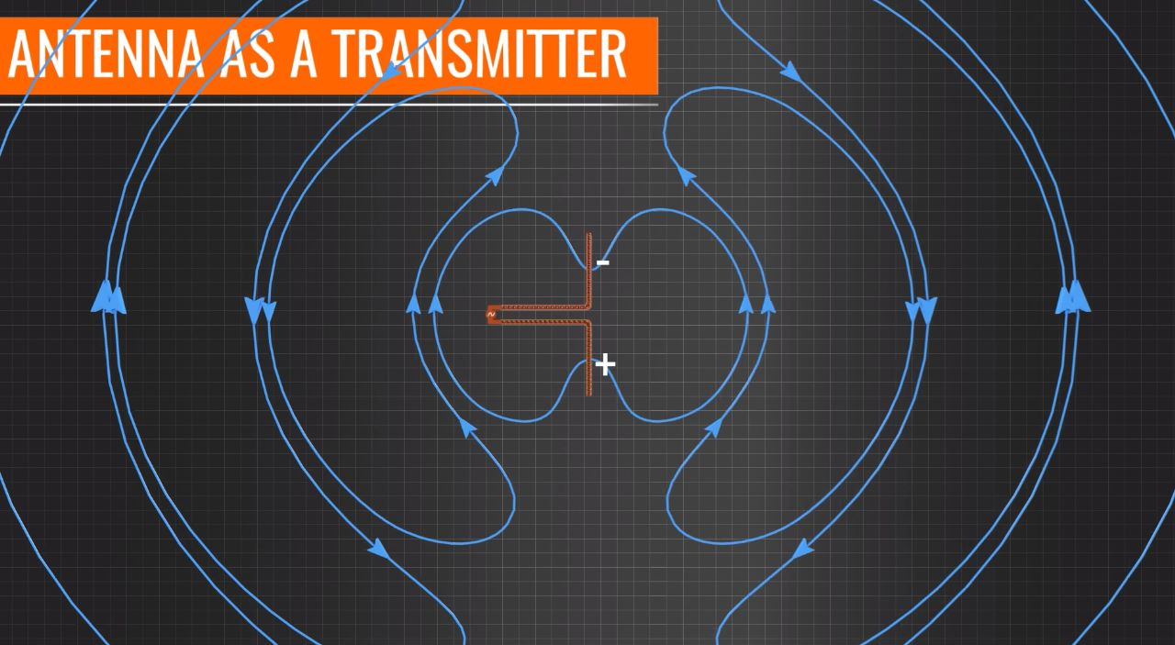
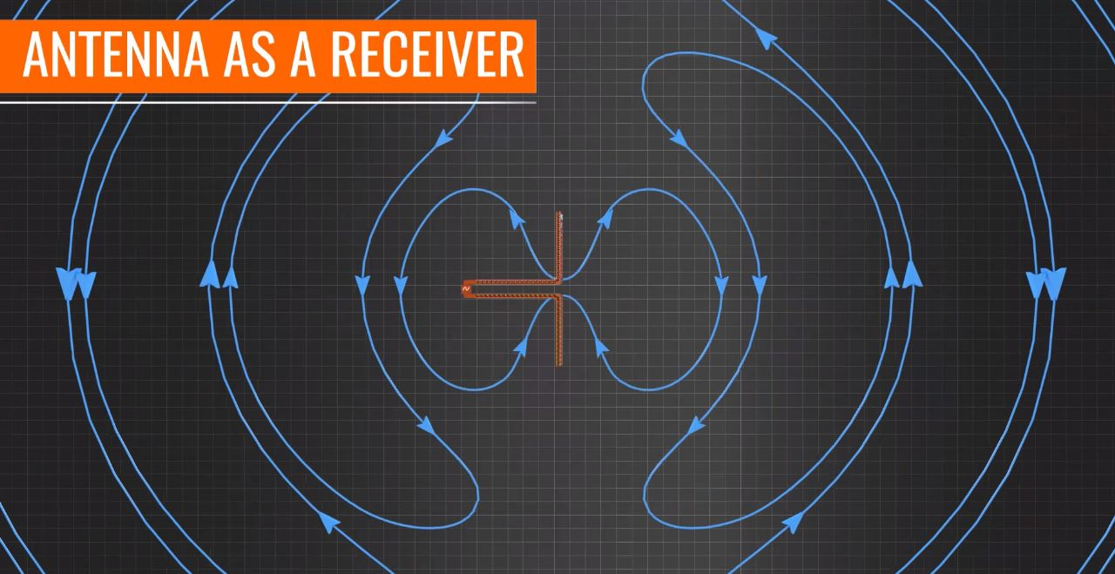

Slide 8
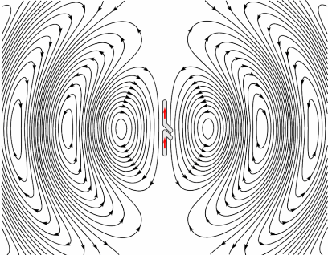

Slide 9
Applications
Data Transfer
Diagnosis
Treatment
Ingestible antennas
Antennas for MRI
Antennas for thermal ablation
Antennas for microwave imaging
On body wearable antennas
Implantable antennas

Slide 10
Antenna parameters
Radiation Pattern
The radiation pattern of an antenna is a plot of the far-field radiation properties of an antenna as a function of the spatial co-ordinates which are specified by the elevation angle (θ) and the azimuth angle (φ).

Slide 11
Azimuth Pattern
The azimuth plane pattern is formed by slicing through the 3D Pattern in the horizontal plane, XY plane in this case
OR
It refers to rotation of the whole antenna around a vertical axis.

Slide 12
Half Power Beam Width
It is an angular width (in degrees) , measured on the major lobe of an antenna
Radiation pattern at half power points i.e the points at which the signal power is half of its
Peak value.
First Null Beam Width
It is the angular separation between the first nulls of the radiation pattern on either
Side of the main beam formed by the array.

Slide 13
What is a Cylindrical Antenna?
The dipoleCylindrical object creates a cylindrical dipole antenna. The length of the cylindrical dipole corresponds to half of the wavelength at the operating frequency.
These antennas are used in wireless communications due to their simple design.
What is Rectangular loop antenna?
The antenna design consists of a rectangular loop and twin U-shaped
patches composed of lossy copper .They are used as Electromagnetic field
Probes in the microwave bands.

Slide 14
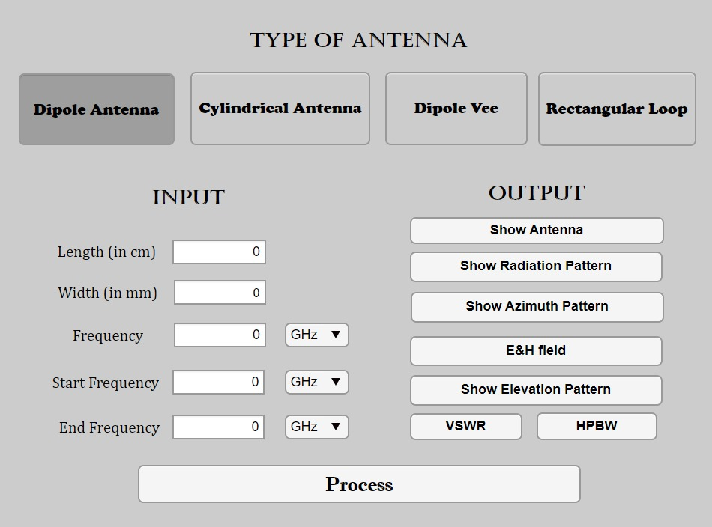
MATLAB APP GUI

Slide 15
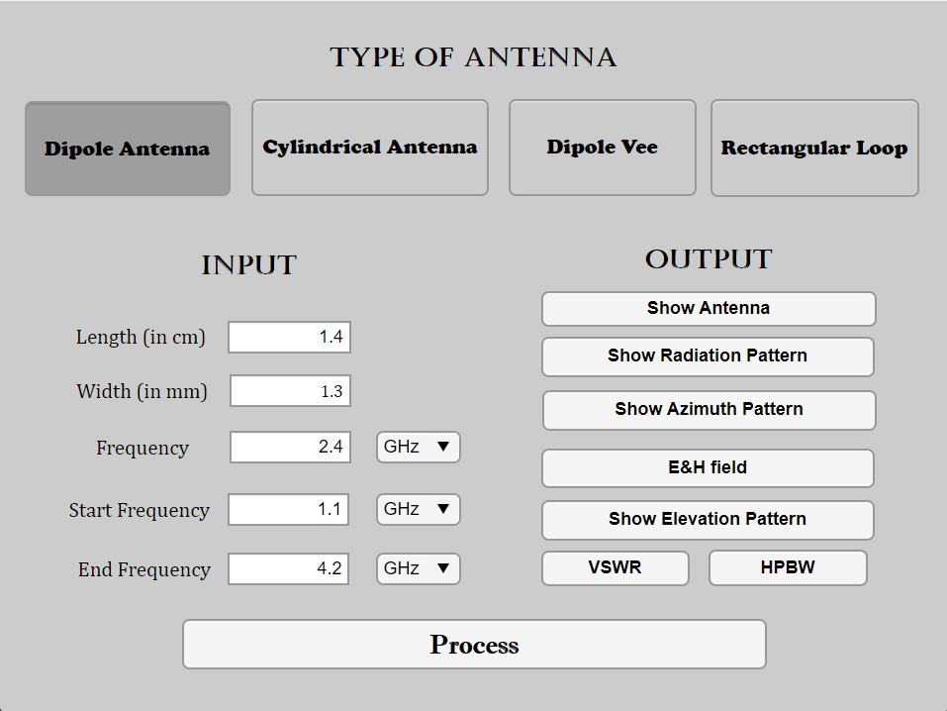
DIPOLE ANTENNA
GRAPHS AND PLOTS

Slide 16
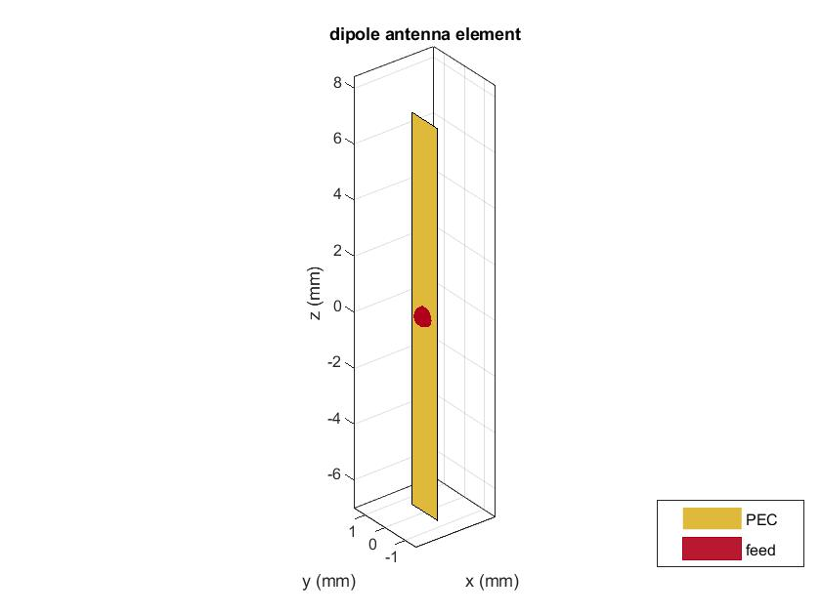

Slide 17
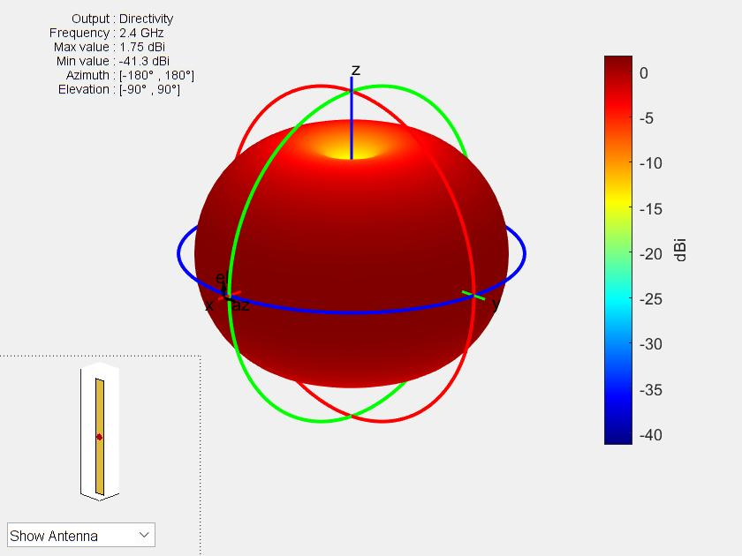
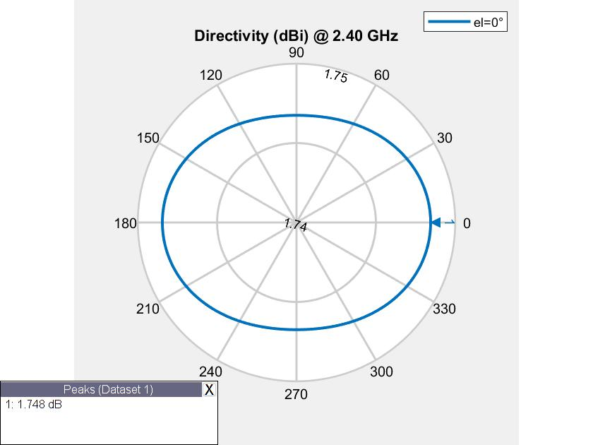
Radiation pattern
Azimuth pattern

Slide 18
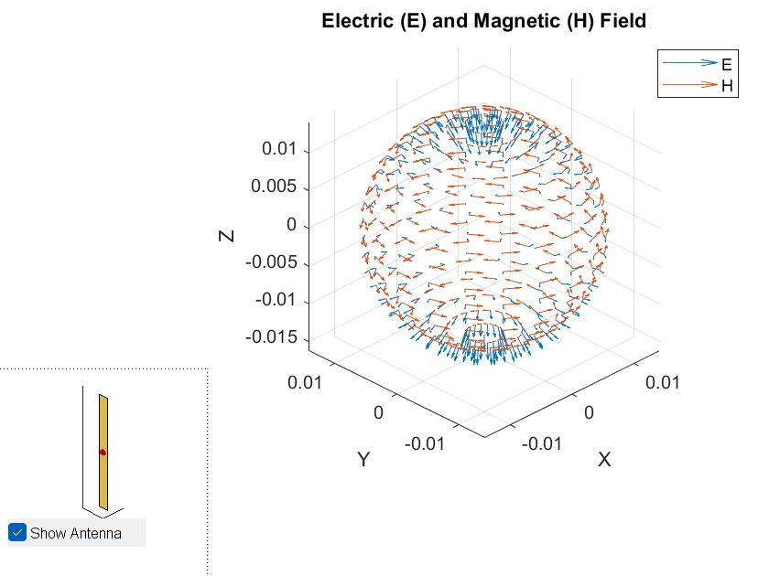
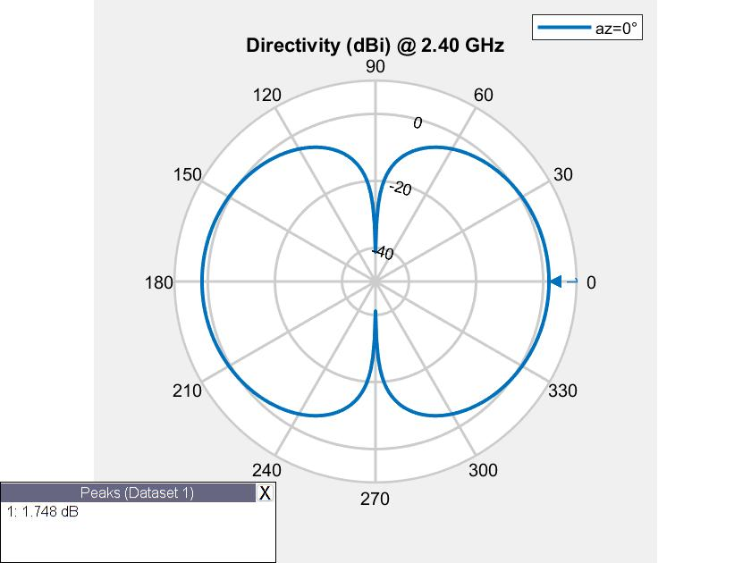
E & H Fields
Elevation pattern

Slide 19
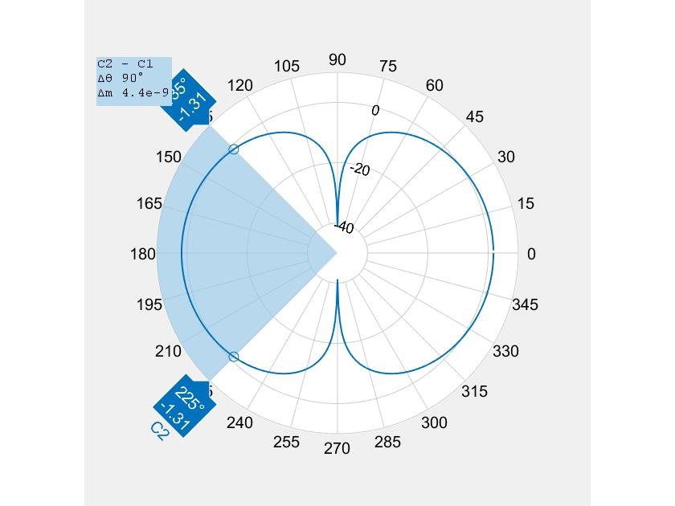
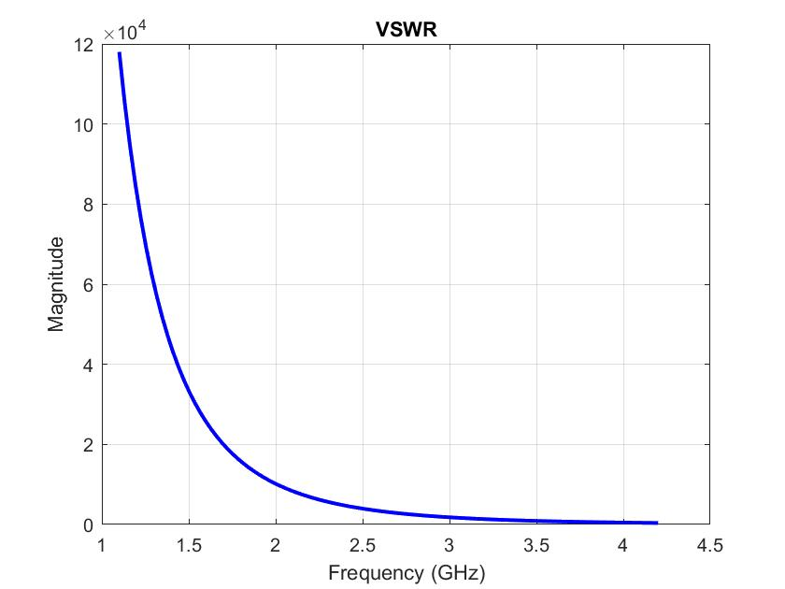
HPBW
VSWR

Slide 20
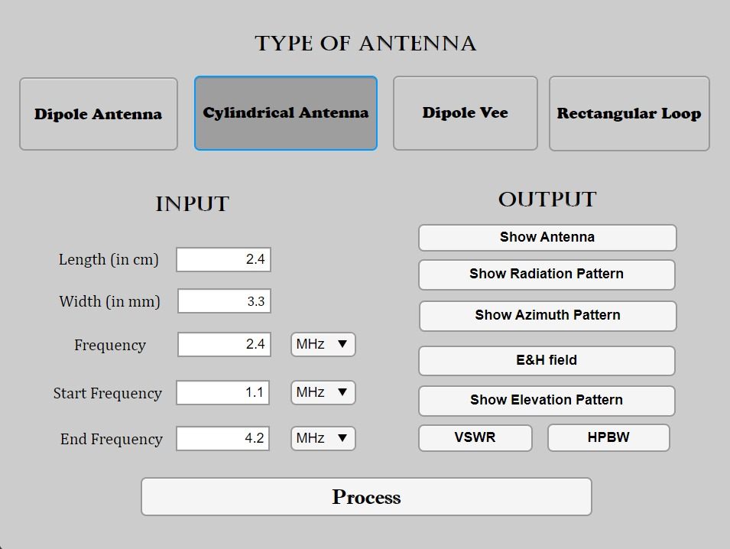
CYLINDRICAL ANTENNA

Slide 21
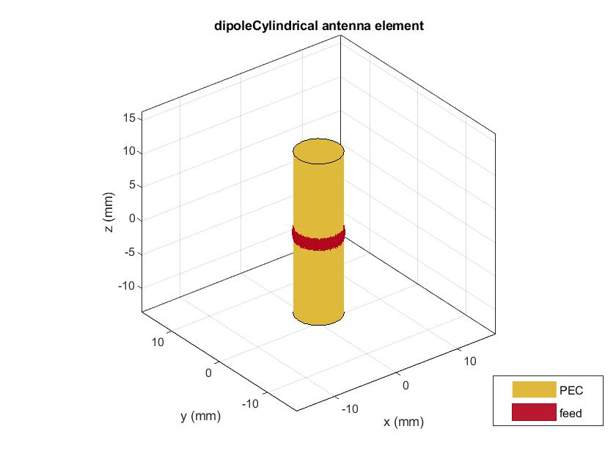

Slide 22
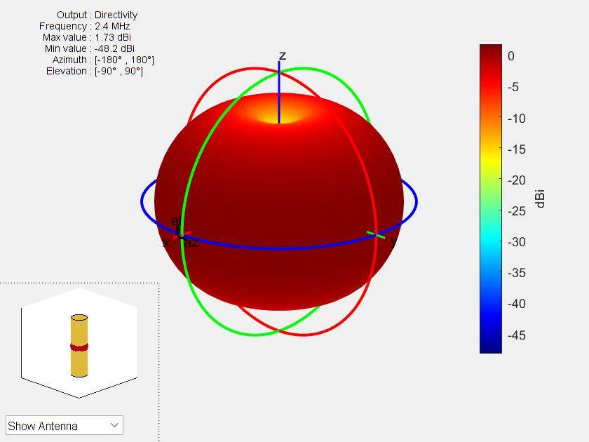
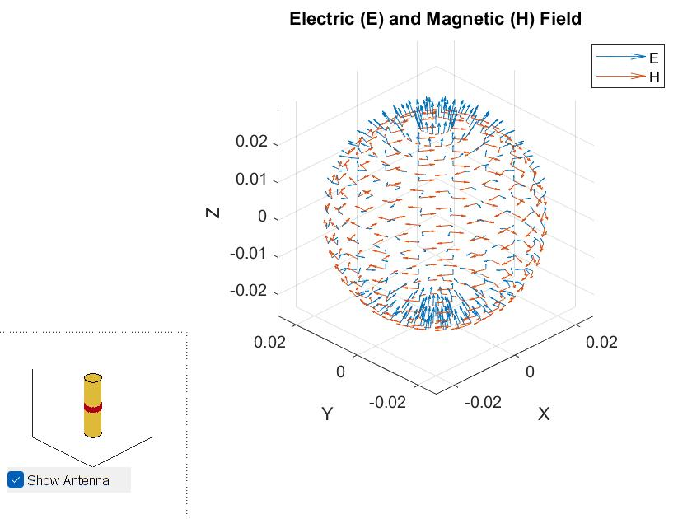
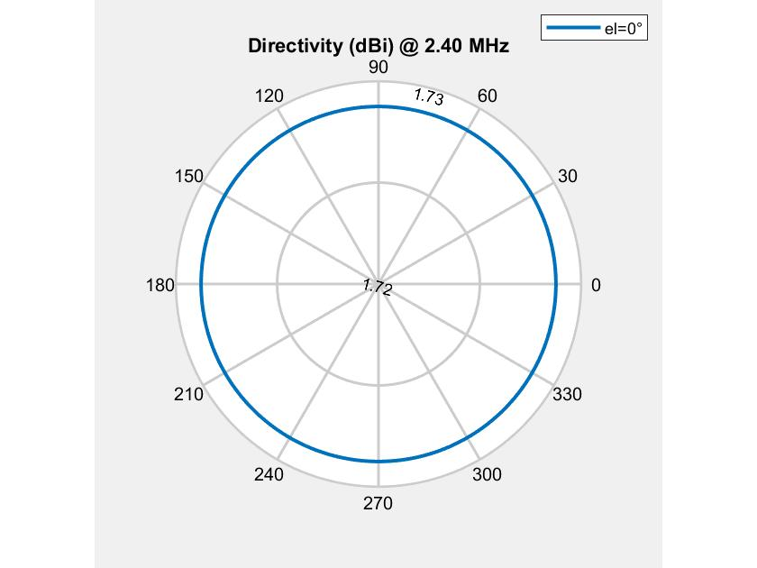

Slide 23
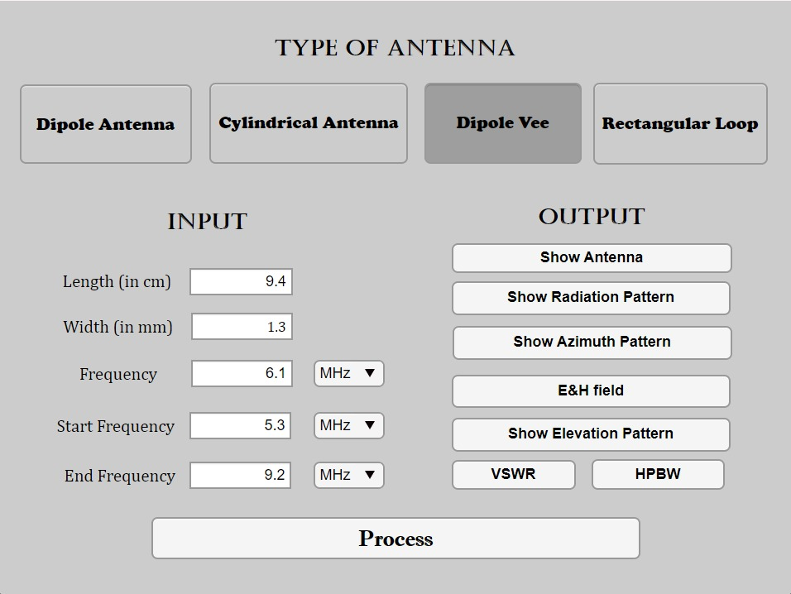
DIPOLE VEE

Slide 24
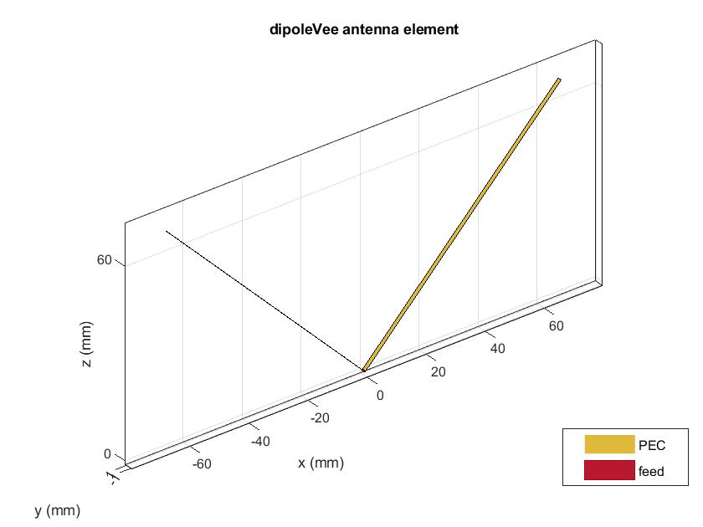

Slide 25
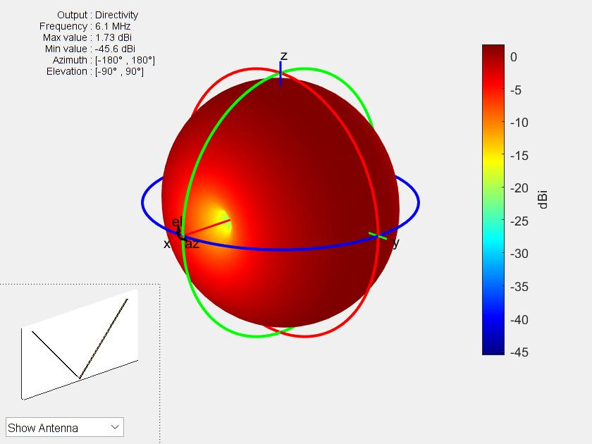
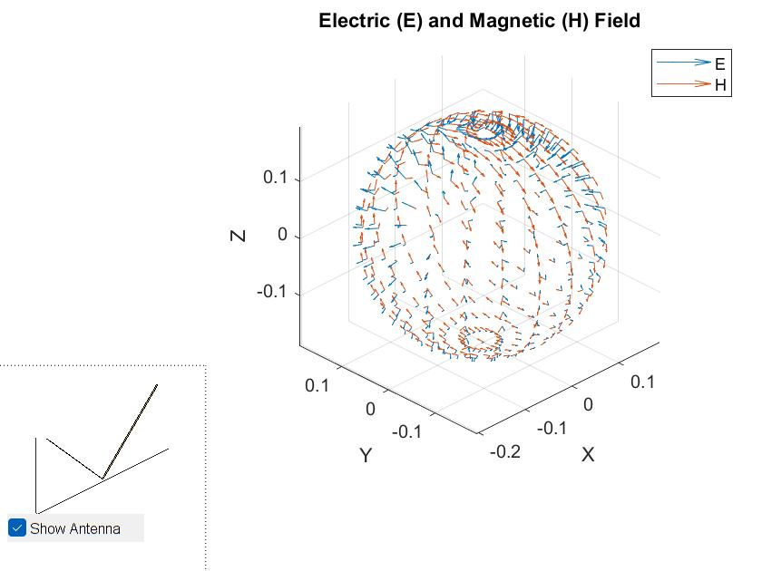
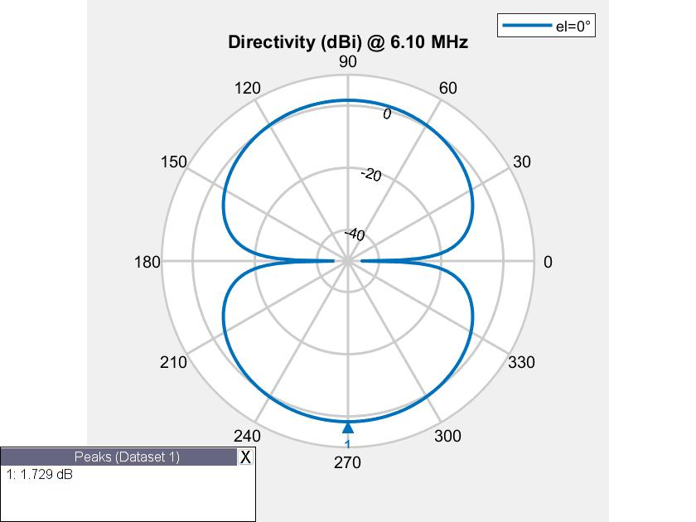

Slide 26
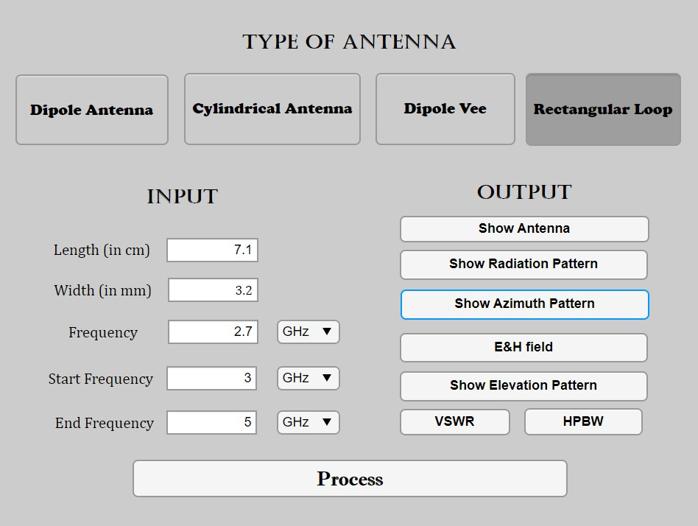
RECTANGULAR LOOP

Slide 27
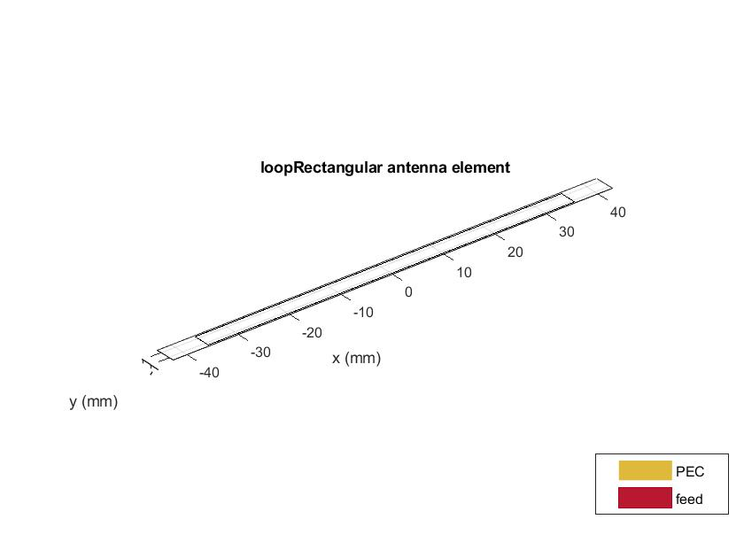

Slide 28
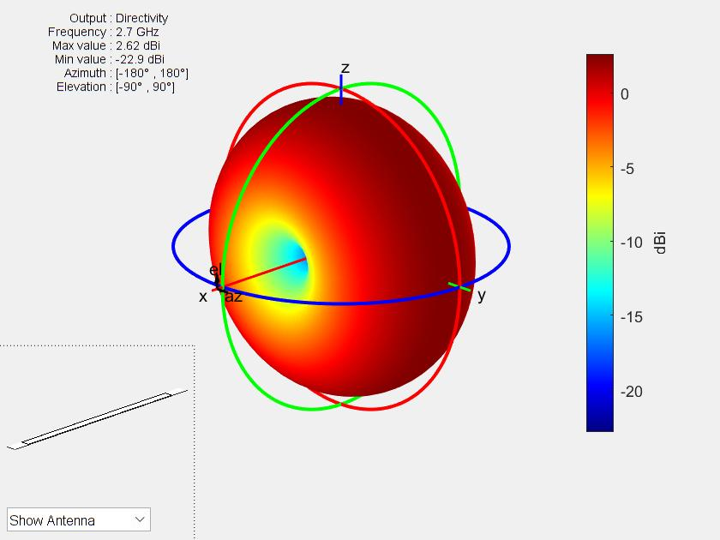
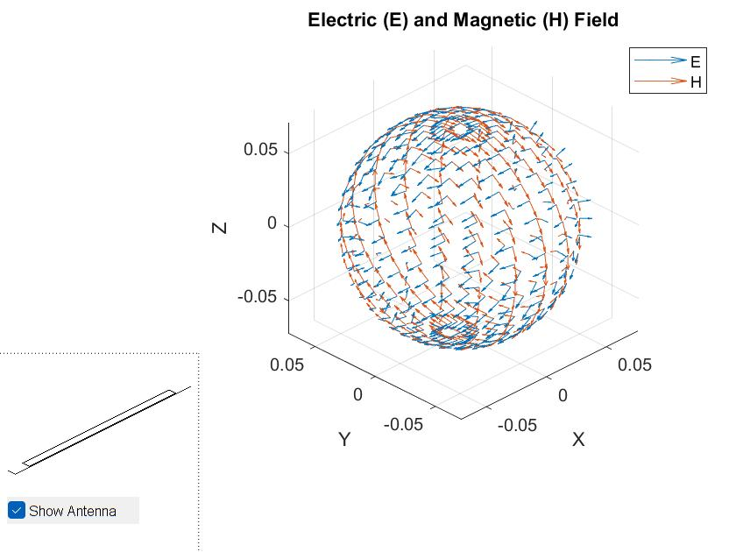
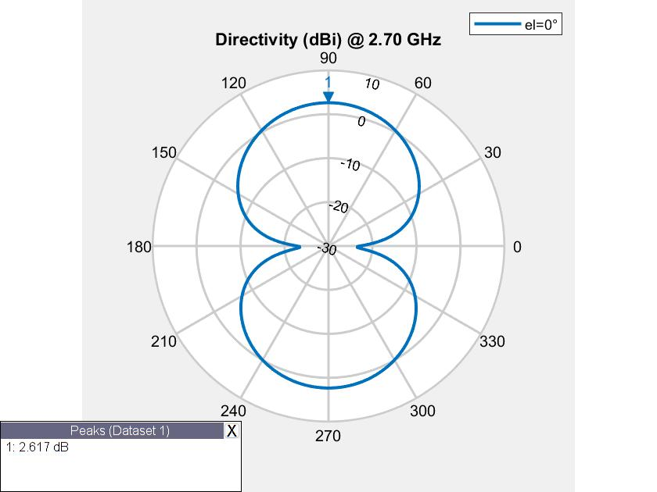

Slide 29
Lets Simulate

Slide 30
There are no straight lines in Physics.
-R Buckminster Fuller

Slide 31
Thanks and regards
Bellamkonda Jai Abhiram
Yelagandula Rohan Sai
Vankudoth Prashanth
Bellamkonda Avinash
Bhamidipati S V Shashanka

